Slide 1
Laparoscopic TAPP Hernia repair:
patient reported outcomes
Mr Naveed Hossain
Mr Rateb Katmeh
Mr Luis Soares
Department of General Surgery
Barnet and Chase Farm Hospitals
Royal Free London NHS Foundation Trust

Slide 2
Background
Becoming more minimally invasive
Trend towards using smaller and fewer ports in minimally invasive surgery
- 3 port technique for laparoscopic cholecystectomy
- Needlescopic techniques
A three- 5mm port technique for Laparoscopic TAPP inguinal hernia repair was developed at the Trust

Slide 3
Inguinal Hernia Repair
Approximately 79,000 hernia operations take place per year in the UK ^{1,} and more than 20 million worldwide ².
Minimally invasive techniques have demonstrated benefits compared to open including reduced:
early and late postoperative pain
wound infection rate
haematoma formation
incidence of chronic pain³
96% of port site hernias in a recent series were a result of 10mm trocars⁴
Royal College of Surgeons of England. Report: A Dangerous Waiting Game? 2018.
HerniaSurge Group. International guidelines for groin hernia management. Hernia. 2018;22(1):1-165. doi:10.1007/s10029-017-1668-x
Schmedt CG, Sauerland S, Bittner R. Comparison of endoscopic procedures vs Lichtenstein and other open mesh techniques for inguinal hernia repair: a meta-analysis of randomized controlled trials. Surg Endosc. 2005;19(2):188-199. doi:10.1007/s00464-004-9126-0
Lambertz A, Stüben BO, Bock B, et al. Port-site incisional hernia - A case series of 54 patients. Ann Med Surg (Lond). 2017;14:8-11. Published 2017 Jan 6. doi:10.1016/j.amsu.2017.01.001

Slide 4
Port Placement
The optical port (5–10mm) is placed just below the umbilicus in the midline.
Place two additional 10-mm working ports lateral to the rectus sheath on either side at the level of the umbilicus. These may be used to pass the mesh into the abdomen and to accommodate the hernia stapler.
Alternatively, a 5-mm helical tacker may be used, allowing for 5-mm lateral ports. The mesh can then be passed blindly through the 10-mm optical port. There are also data to support not fixing the mesh, although migration has been observed.

Slide 5
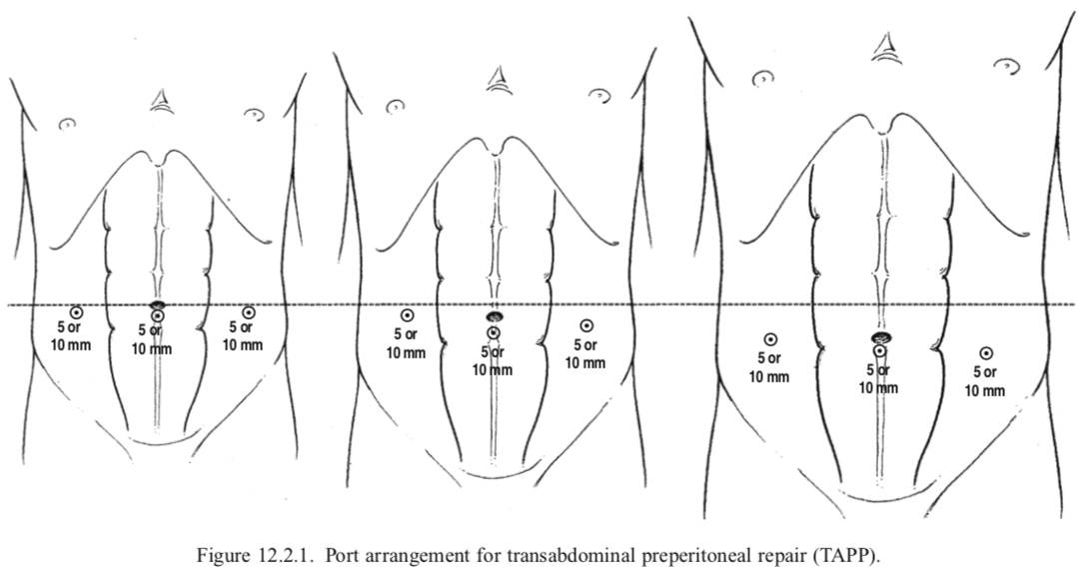
Total Abdominal Pre Peritoneal (TAPP)
Thoman D.S., Phillips E.H. (2006) Hernia Repair: Patient Positioning and Operating Room Setup. In: Whelan R.L., Fleshman J.W., Fowler D.L. (eds) The Sages Manual. Springer, New York, NY. https://doi.org/10.1007/0-387-29050-8_18

Slide 6
Surgical Technique
Preassessment, COVID-19 test, WHO checklist, GA
Veress needle insufflation 12mmHg, supra umbilical incision
3 x 5mm ports
Preperitoneal pocket made large enough to accommodate mesh and expose symphysis pubis, midline of rectus and coopers ligament. Hernia reduced.
Mesh introduced via 5mm port site
Mesh secured with 5mm tacker and peritoneum approximated

Slide 7
Three 5mm ports
Surgical technique
This is possible due to the availability of:
- 5mm camera
- 5mm tacker
Mesh is introduced through the 5mm port site (port removed temporarily) under vision

Slide 8
Pros and Cons
Less chance of port site hernia
Better cosmesis
Easier closure
Potential for trauma to port site
Potential for bleeding
Potential for infection of port site and mesh

Slide 9
Patient Reported Outcomes
A questionnaire developed using the following domains
Telephone follow up was carried out for patients at least one year post surgery
Post procedural pain
Postoperative- (2 weeks)
Acute (2 weeks – 6 months)
Early chronic (6-12 months)
Late chronic (> 1 year)
Paraesthesia
Time to return to work/daily activities
Return to hospital
Recurrence of inguinal hernia
Port site hernia
Wound infection
Satisfaction

Slide 10
Demographics
175 patients in total underwent TAPP hernia repair between 2015 and 2019 by a single surgeon
89 patients were selected between July 2017 and October 2019 for telephone follow up
58 patients responded (65%)
24 underwent bilateral repair representing a total of 82 TAPP hernia repairs
Mean age (± SD) |  | 67 ±14 years
Gender (%) | Male Female | 56 (96) 2 (4)
Hernia type (%) | Unilateral Bilateral | 34 (58.6) 24 (41.4)
ASA (%) | I II III | 27 (46.55) 27 (46.55) 4 (6.9)

Slide 11
Postoperative Pain
Postoperative pain in first two weeks post op
Low incidence of chronic pain

Slide 12
Frequency

Slide 13
Paraesthesia
89.7% experienced no paraesthesia

Slide 14
Period of Disability / Return to work

Slide 15
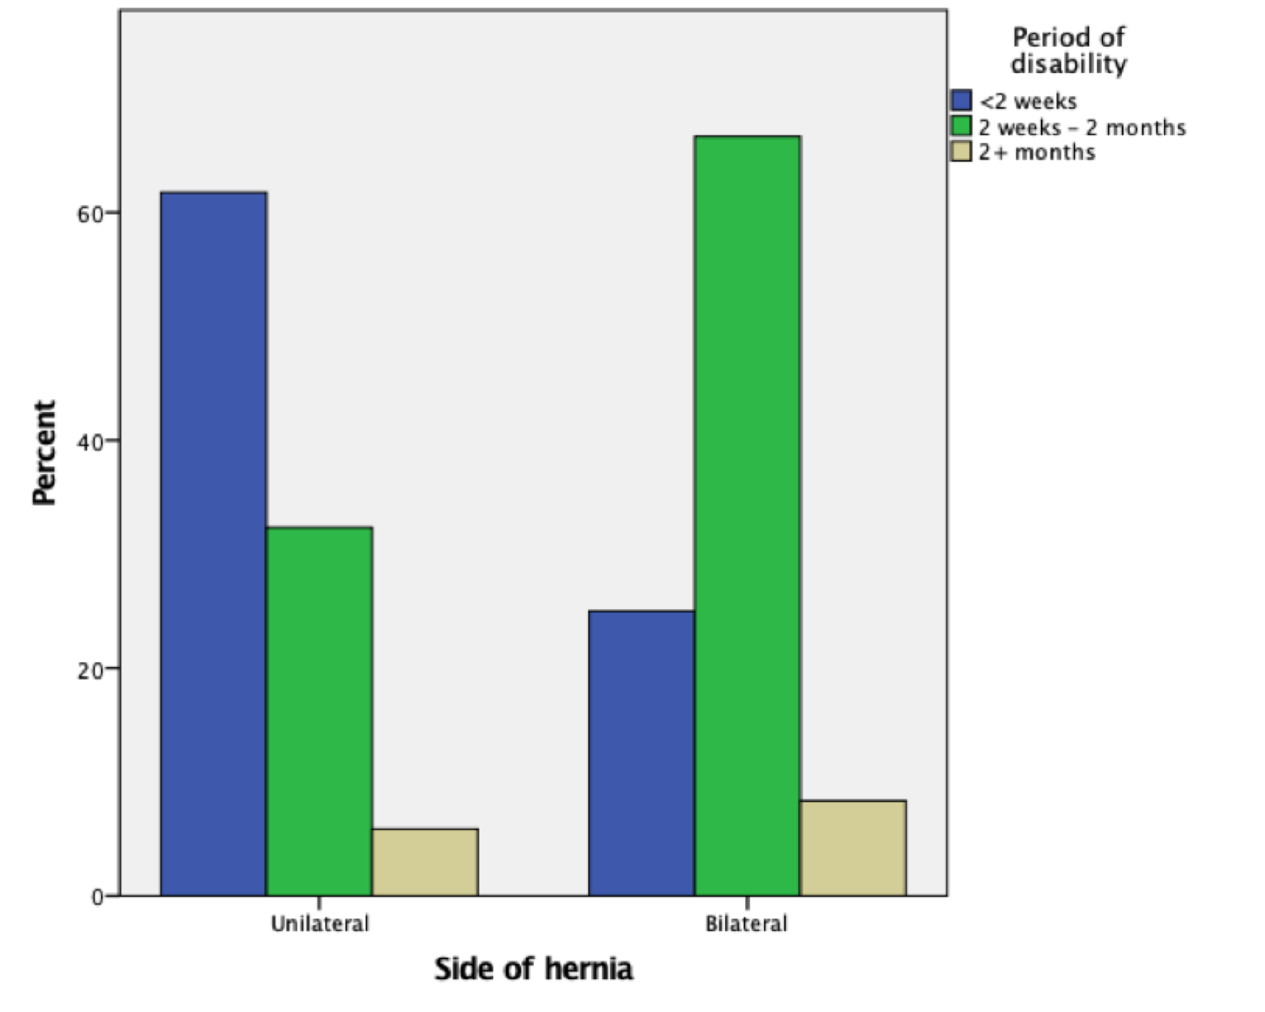
Unilateral vs Bilateral repair
Period of disability was significantly shorter for unilateral hernias, (p=0.021).
No significant difference between two groups regarding time off work (p=0.791).
Factors other than pain and mobility, such as financial implications may influence this outcome.

Slide 16
Other outcomes
3 patients (5.1%) returned to hospital for reasons of constipation, urinary retention and seroma.
Five hernia recurrences were reported (6.1%) and no port site hernias were reported.
Wound infection which required antibioticswas reported by 2 patients (3.4%).

Slide 17
Other outcomes
No mesh infections
No port site hernias
No deaths
No haematomas

Slide 18
Patient Satisfaction
57 out of 58 patients who responded (98.3%) were satisfied with their operation overall
Mean satisfaction score was 9.02/10

Slide 19
Conclusions
A three port 5mm technique is technically feasible without any increase in complication rate
Results show excellent satisfaction rates
May confer benefits of quicker recovery, better cosmesis, and fewer port site hernias

Slide 20
Future developments
Use of AirSeal 7mm valveless port
May confer protection against airborne particles and avoid need for removing trocar

Slide 21
Thank you

